Slide 1

price
suggestion model
Shweta Choudhary
Foram Javia
Ashutosh Shukla

Slide 2
Introduction
Product pricing is hard at scale, considering just how many products are sold online. Clothing has strong seasonal pricing trends and is heavily influenced by brand names, while electronics have fluctuating prices based on product specs. Mercari, would like to offer pricing suggestions to sellers, but this is tough because their sellers are enabled to put just about anything, or any bundle of things, on Mercari's marketplace.
The Problem
The idea is to build an algorithm that automatically suggests the right product prices, to be able to guide the customers who are placing the products to sell (thus increasing their chances of selling the product for the right price and gaining the buyers’ trust of buying the product for the right price as well).

Slide 3
The Dataset :
The given datasets have close to 700,000 observations in the test.tsv, so you need to predict the price value for each item in this dataset. The training dataset (with price value) contains close to 1.5 million observations. Out of given seven variables, three contain numeric data (ID, Price, and Shipping) and four contain string data (Name, Condition, Category, and Brand).
The Solution
To be able to suggest the price of product on Mercari using end-to-end Deep Learning model implemented in TensorFlow. The model is required to train (including all the preprocessing, feature extraction and model training steps) data that includes unstructured text (product title & description) and structured ones, e.g., product category and shipping flag etc. Very minimum preprocessing with focus on end-to-end learning with multi-field inputs, e.g., textual and categorical.

Slide 4



Steps
Followed
As every one does
Exploratory
Data Analysis
Machine
Learning
Comparing and
correcting results
EDA to determine the most important parameters that affect the price of a product on the dataset
Using different text based machine learning models to predict the prices with the most accuracy
Generating prediction on test data and cross validating. Correcting the models to improve accuracy.

Slide 5
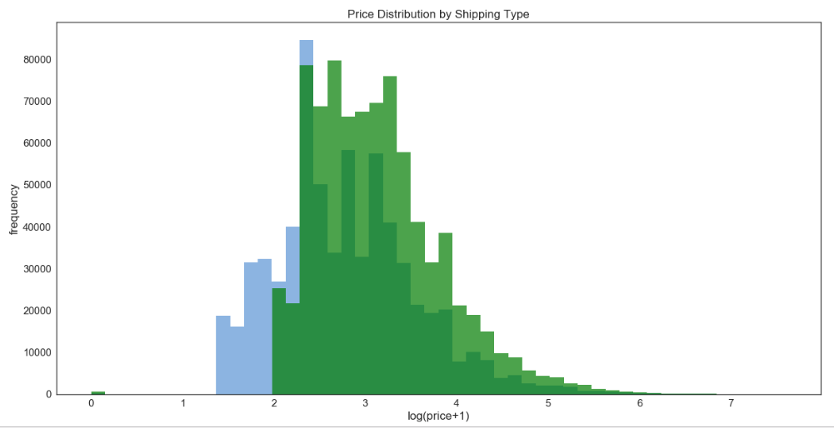
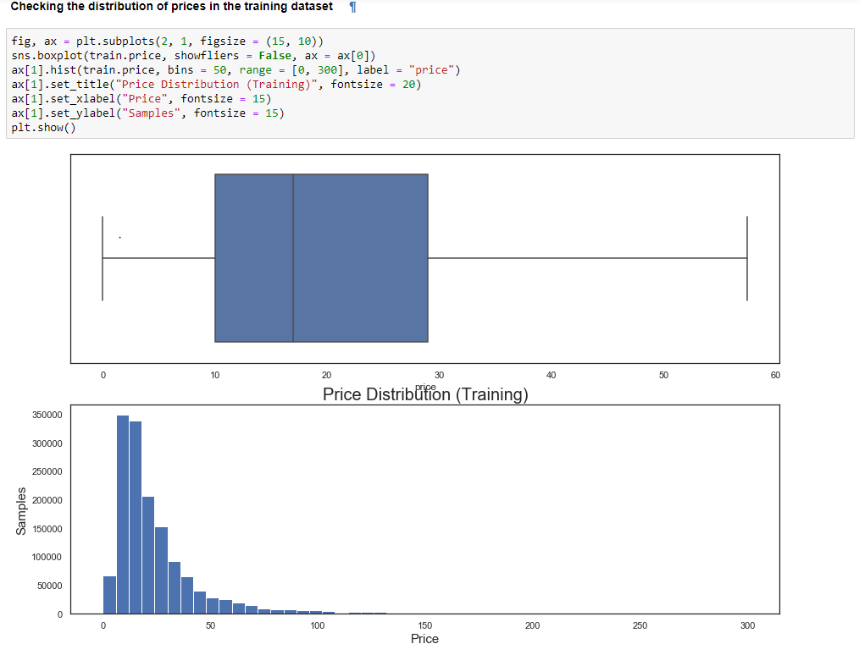
EDA
Prices of the products depend on the shipping cost owned the seller or the buyer
The dataset contains around 1.5 million training and around 7 million test data having attributes : name, item_description, item_condition_id, category_name, brand_name, shipping.
For our analysis the price is the most important feature, we find the distribution of the prices to understand if there are any outliers

Slide 6
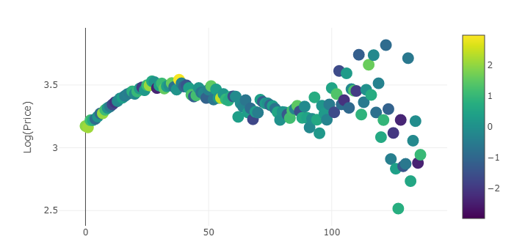
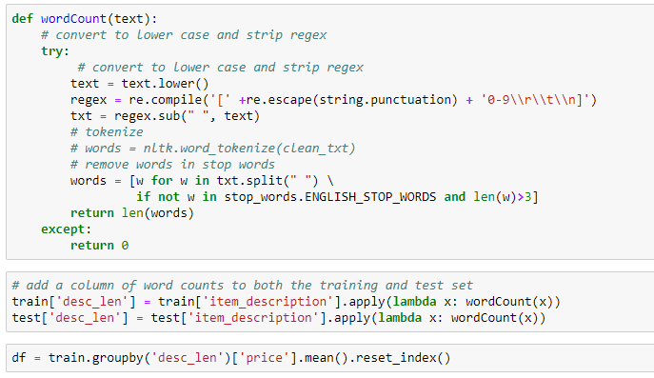
Price based on the length of item description
We see that the price is not dependent on the item description

Slide 7
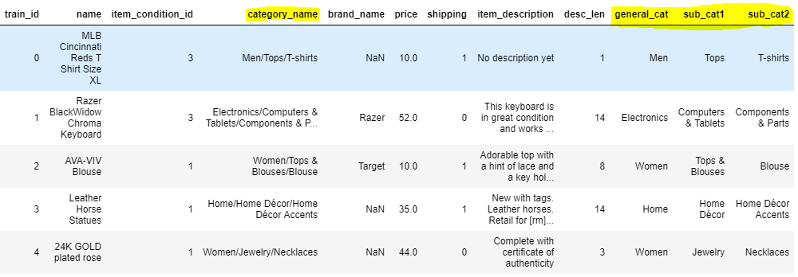
Splitting the main category column into sub categories

Slide 8
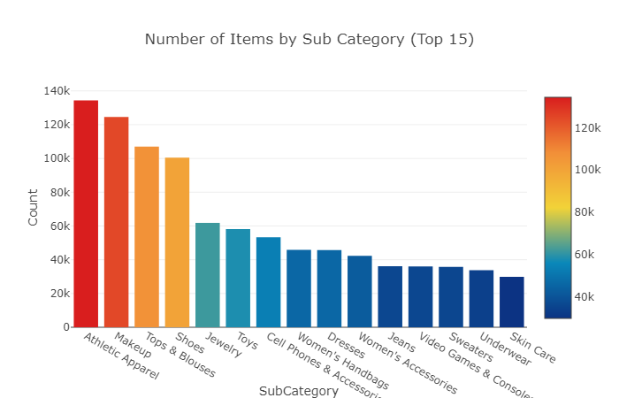
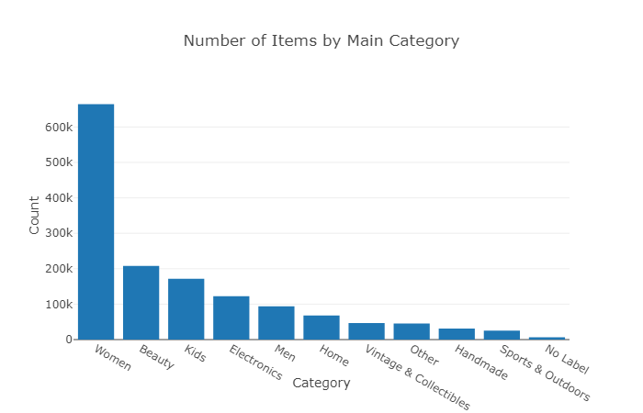
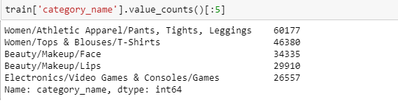
Number of products In each category

Slide 9
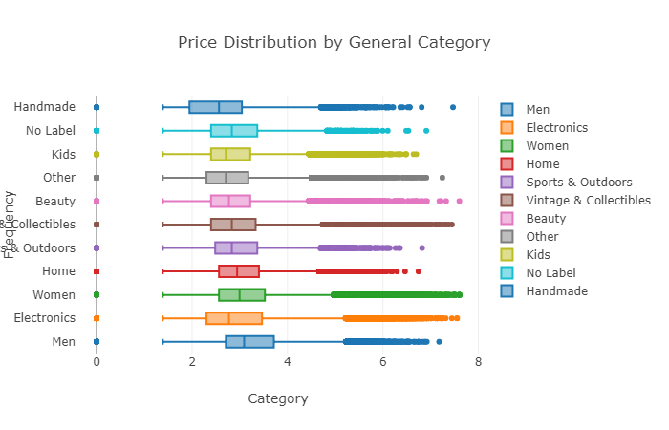
Price of products In each category

Slide 10
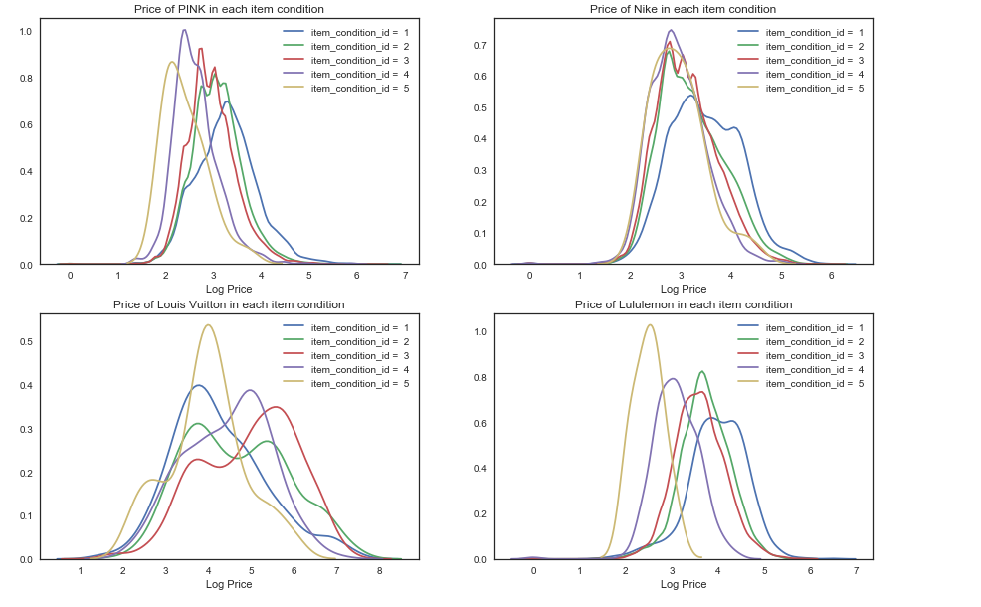
Price of products from top brands based on the condition divided in 5 types

Slide 11
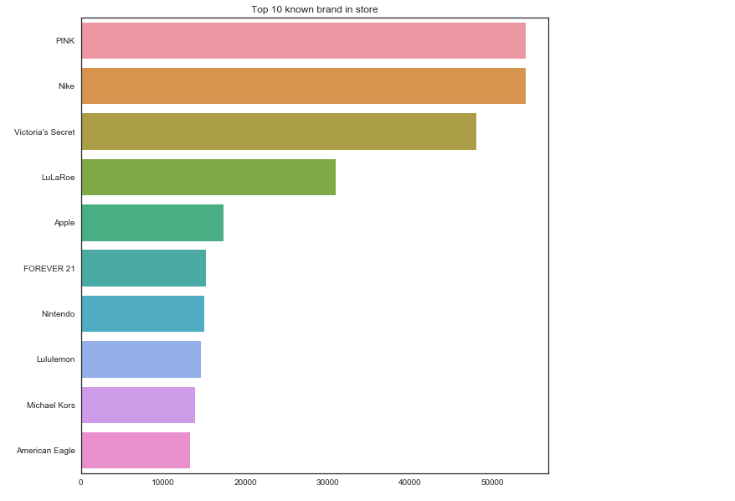
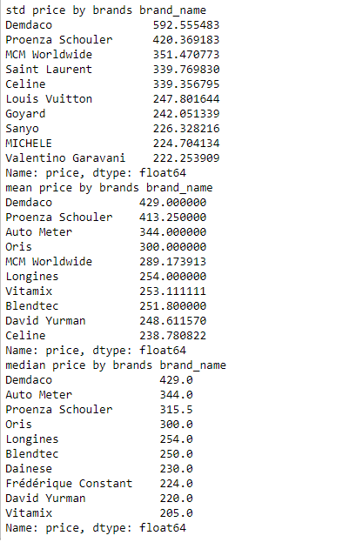
Top Brands and std prices

Slide 12
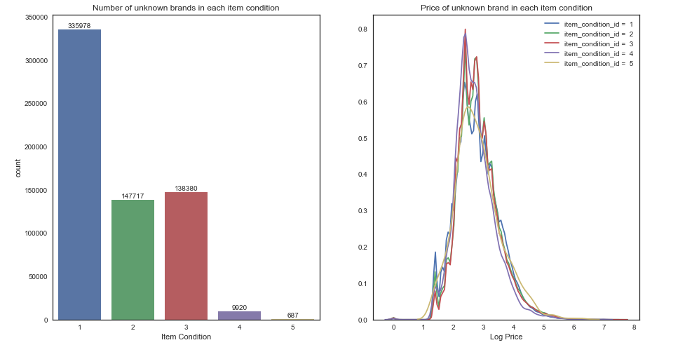
We found that 42% of the brand names are null
WRITE SOMETHING HERE
Instead of removing these columns we tried to fill these values from the item description using fuzzyset library and using the most common word with the confidence level as 1 replaced the brand name with that.

Slide 13
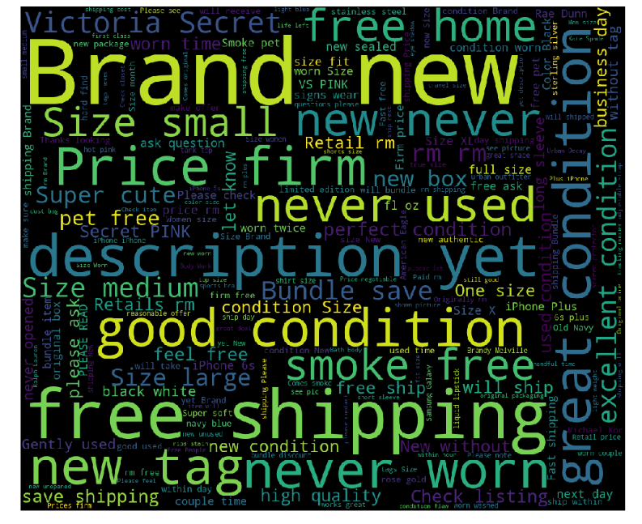
Word cloud

Slide 14
The Models used are:
1. Ridge Regression model.
2. Recurrent Neural Network Model.
3. Multi Feature Tensor Flow Model.
4. Random Forest Regression Model.

Slide 15
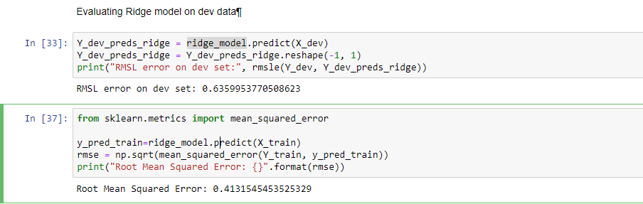
1. Ridge Regression Model
The more inputs the better with Ridge, but it does cost a bit of time.
The Root Mean Square Logarithmic Error for our Ridge Regression Model came out to be approximately 0.6359, which is slightly better than the other models that we have used .
This actually is a good model to predict the prices on our data set.

Slide 16
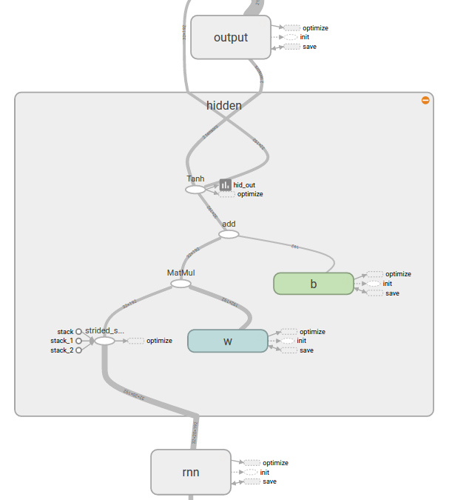
2. Recurrent Neural Network
Neural Networks always have lots of parameters to play with, it is a time for predictive power trade. (learning rate/decay, batch size, embedding output dimension, adding or removing layers, etc.)
The RNN model trained on our dataset gave the following values:
*Root Mean Square Logarithmic Error - 0.4932
Parameters used as Inputs - "Name" , "Item_Desc" , "Brand Name" , "Category Name“
Target Output - "Price"

Slide 17
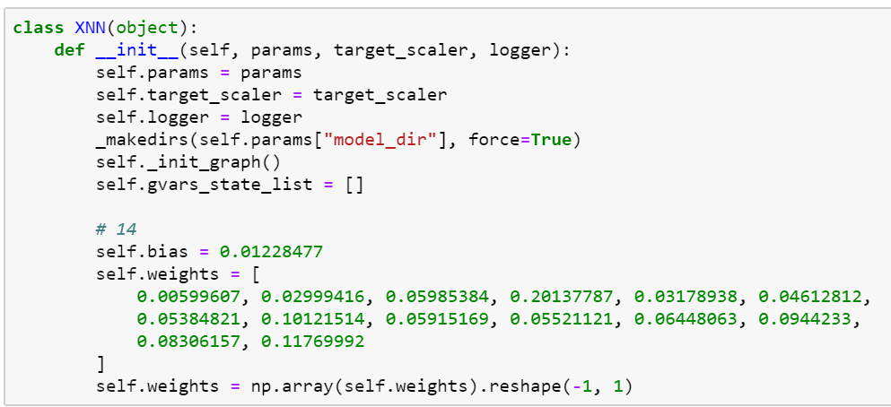
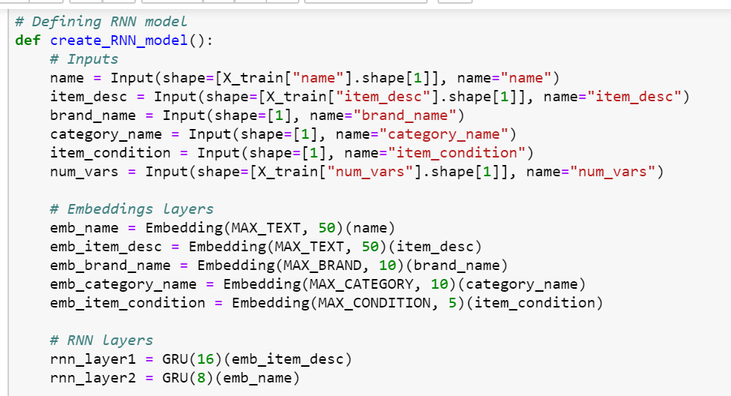

Slide 18
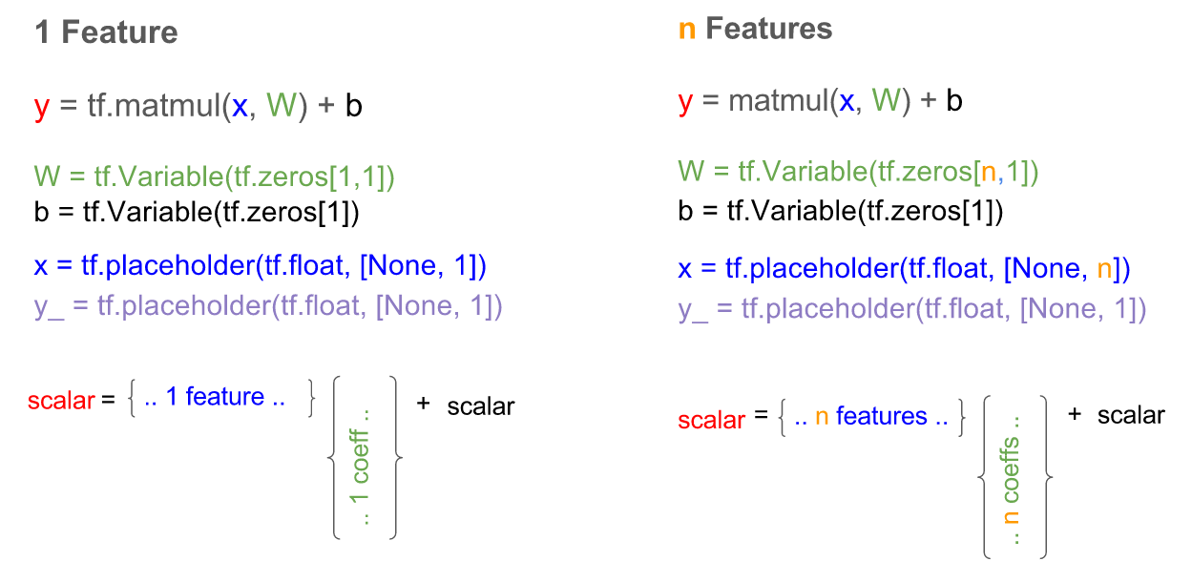
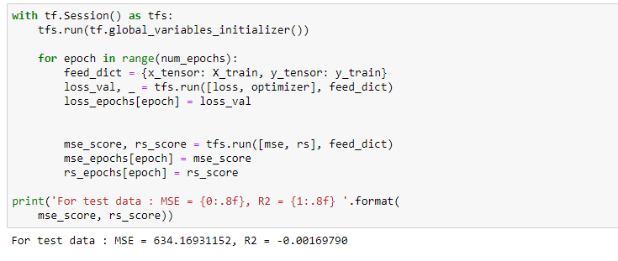
3. Multi Feature Regression Model Using Tensor Flow
In the multi feature Regression model Data is represented in multi-dimensions, which fits the way we want to represent a datapoint with n features (also known as the feature matrix) and a model with n weights (also known as the weight matrix)
An n feature model , in mathematical form can be written as :
y = (x1.W1 + x2.W2 + ....... + xn.Wn) + b
where, x1,x2,.....xn -- Placeholders for each value of feature (1 to n ) to each data point. W1, W2, W3,..... ,Wn -- Weights for each feature . b is the bias.
In Tensor Flow, the features and the weights would be written as:
x = tf.placeholder(tf.float, [1,n])
W = tf.Variable(tf.zeros[n,1])
This model gave us an RMSE of -0.2 .We see that the accuracy is low for this model as well. We need to optimize the model for better accuracy. Maybe by changing the number of features or the kind of features.

Slide 19
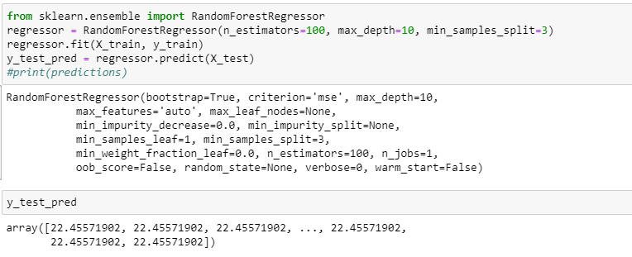
4.Random Forest Regression model
RMSE Score : 0.7932

Slide 20
Thank you…!!!

Slide 21
References
https://www.kaggle.com/c/mercari-price-suggestion-challenge
https://www.kaggle.com/c/mercari-price-suggestion-challenge/data

